Slide 1
Unit 3 Look at me!
PartA: Let's learn
Let's do
福泉市第五小学
蒋双梨

Slide 2
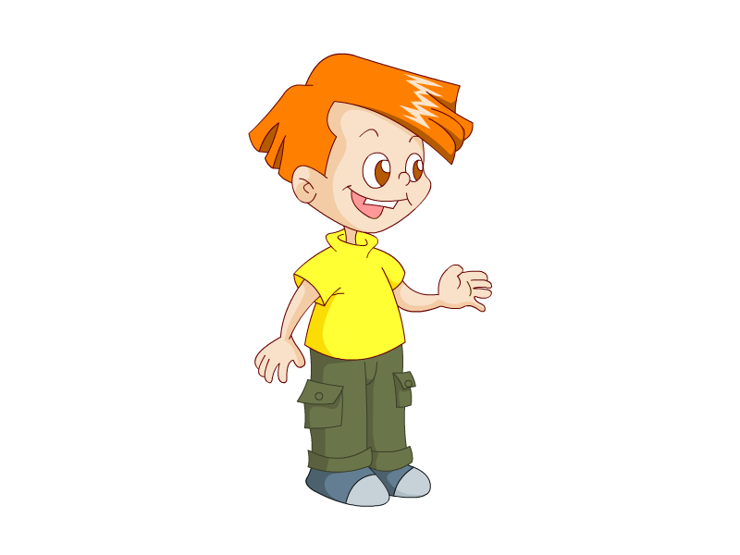
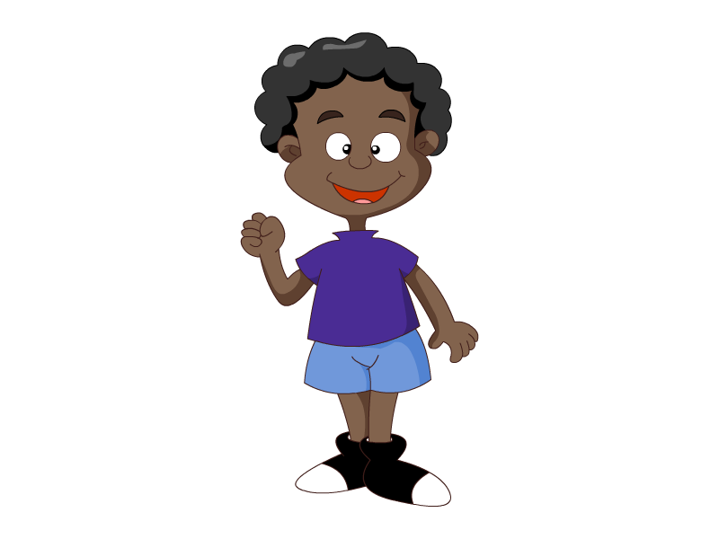
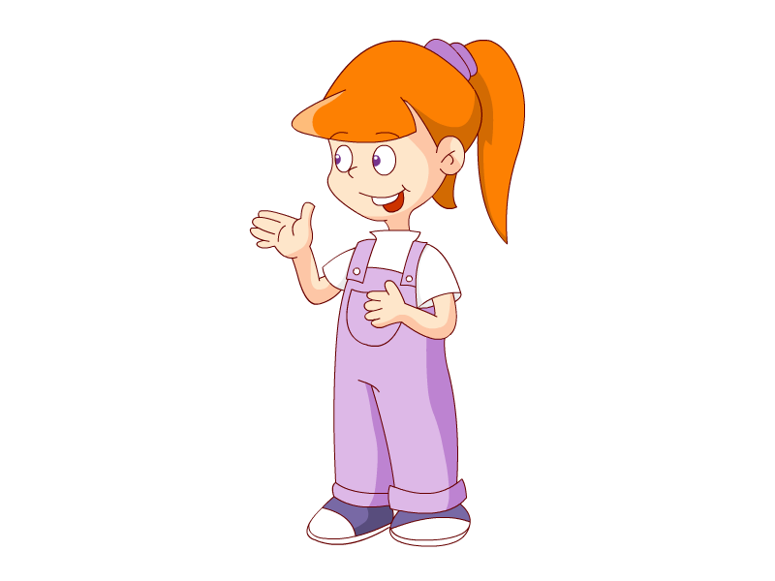
Let`s sing a song!
《Hello》

Slide 4
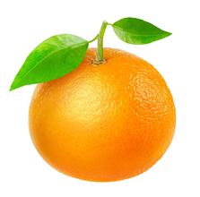
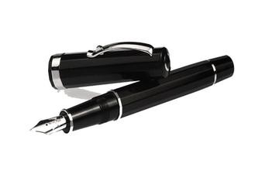
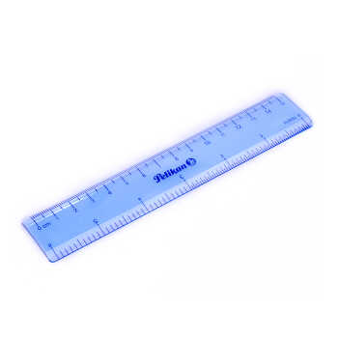
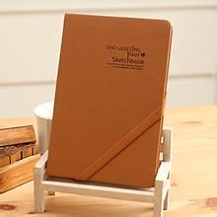
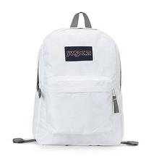
This is a . It's .

Slide 5
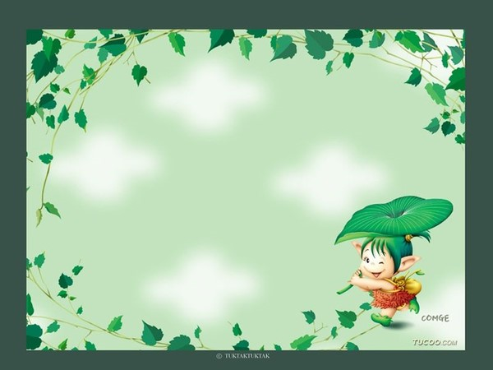
Play a game

Slide 6
Hello !
I’m Teddy bear(玩具熊) .

Slide 7
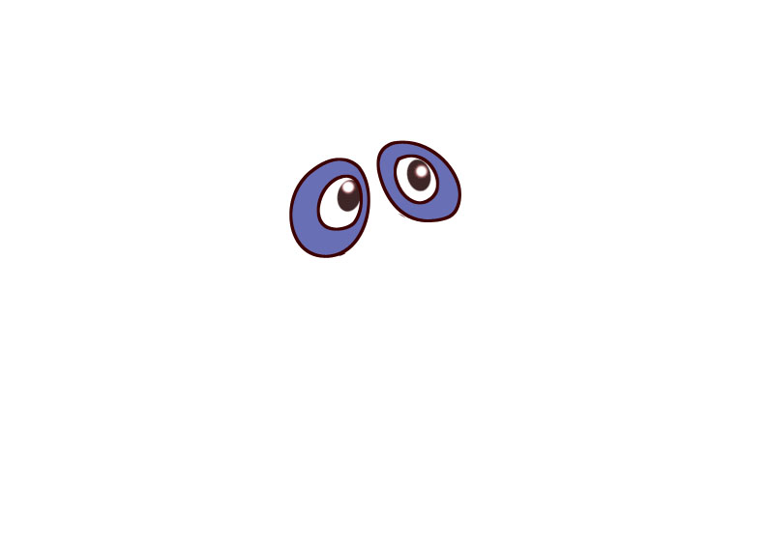
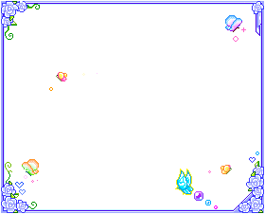
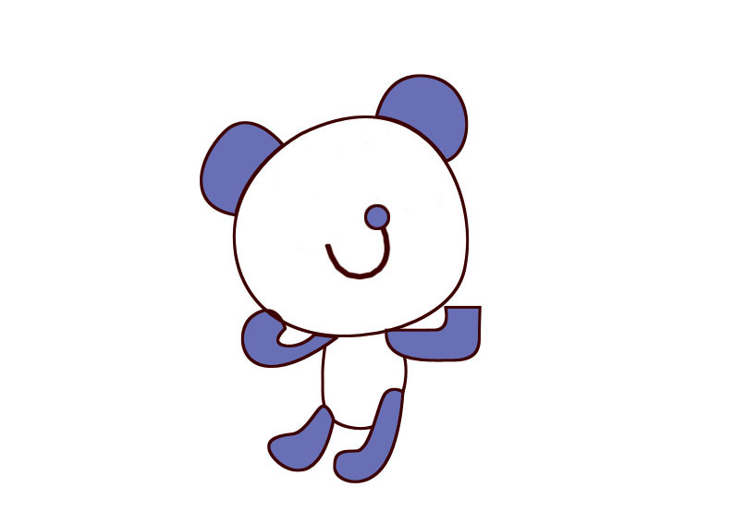
eye
eyes
What are missing?
(没了什么？）

Slide 8
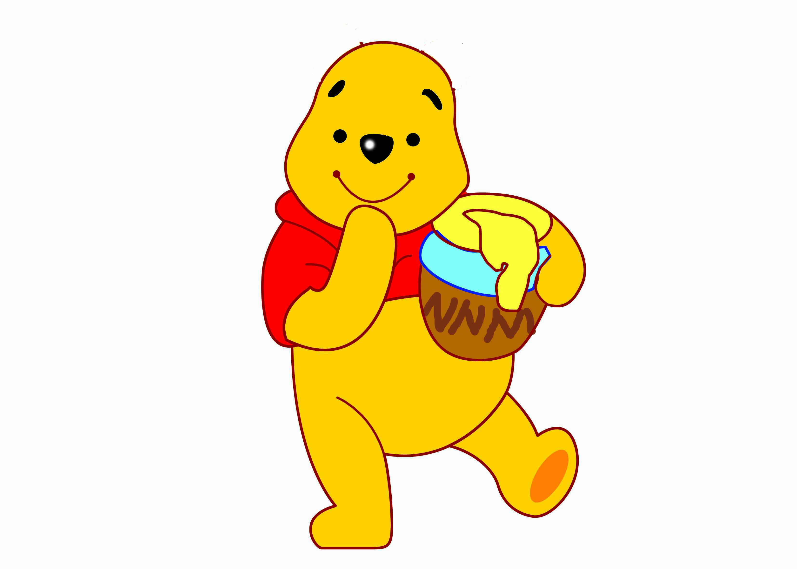
What are missing?
（没了什么？）
ear
ears

Slide 9
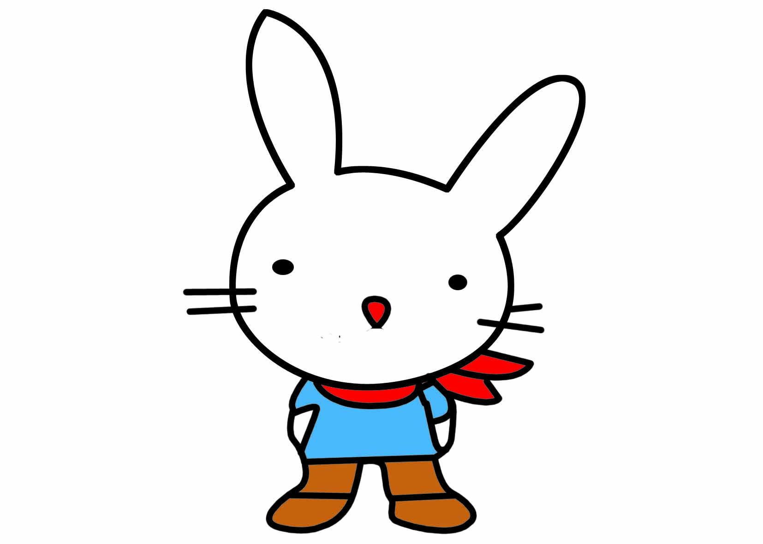
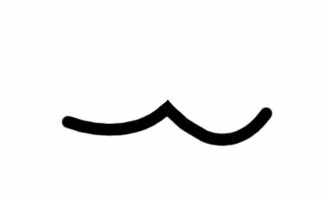
What’s missing?
mouth

Slide 10
What can you see?

Slide 11
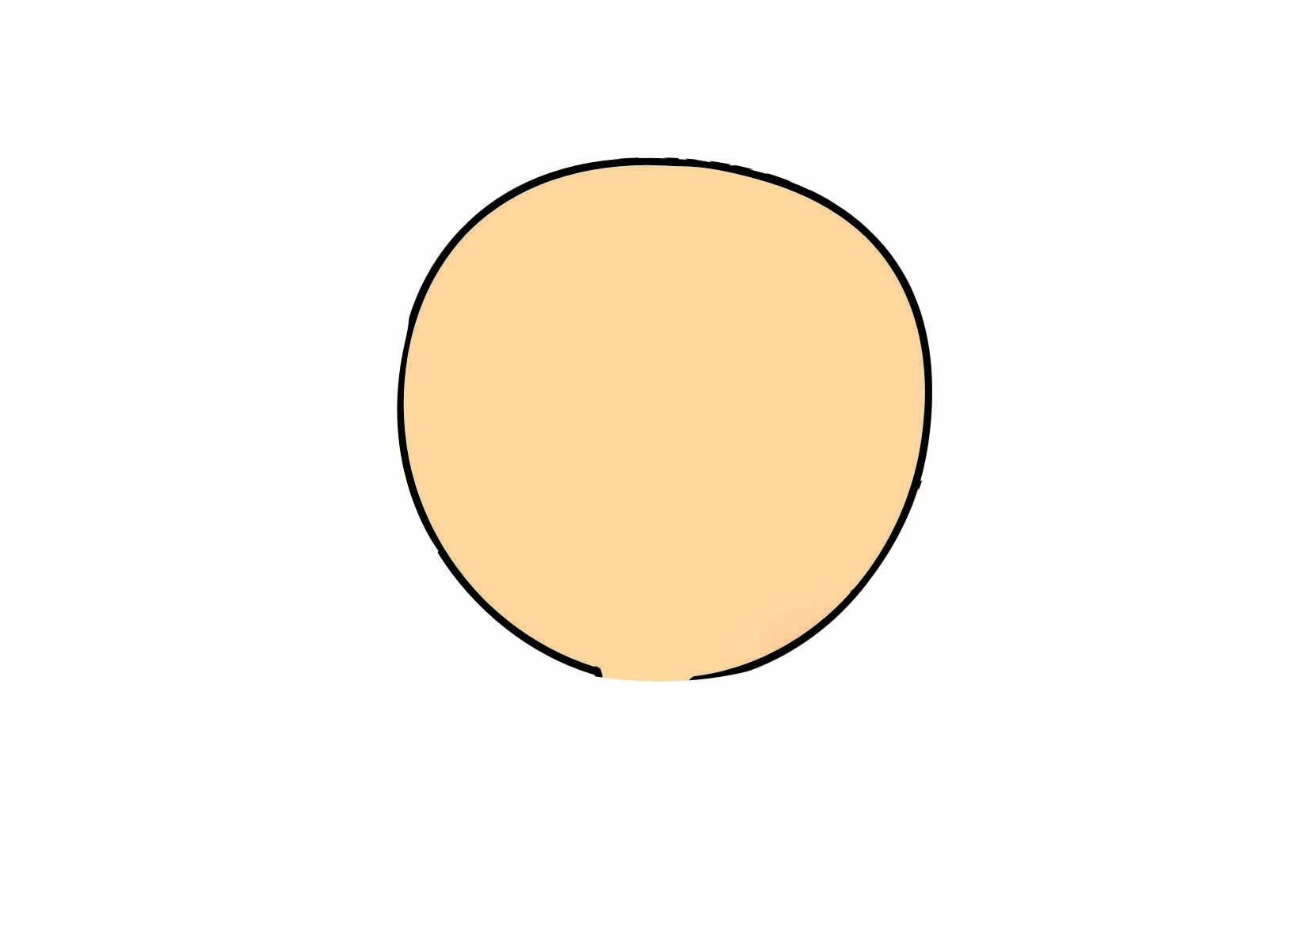
face
This is my face .

Slide 12
eye
This is my eye.

Slide 13
ear
This is my ear .
Touch your ear.

Slide 14
nose
This is my nose .
Touch your nose.

Slide 15
mouth
This is my mouth .

Slide 16
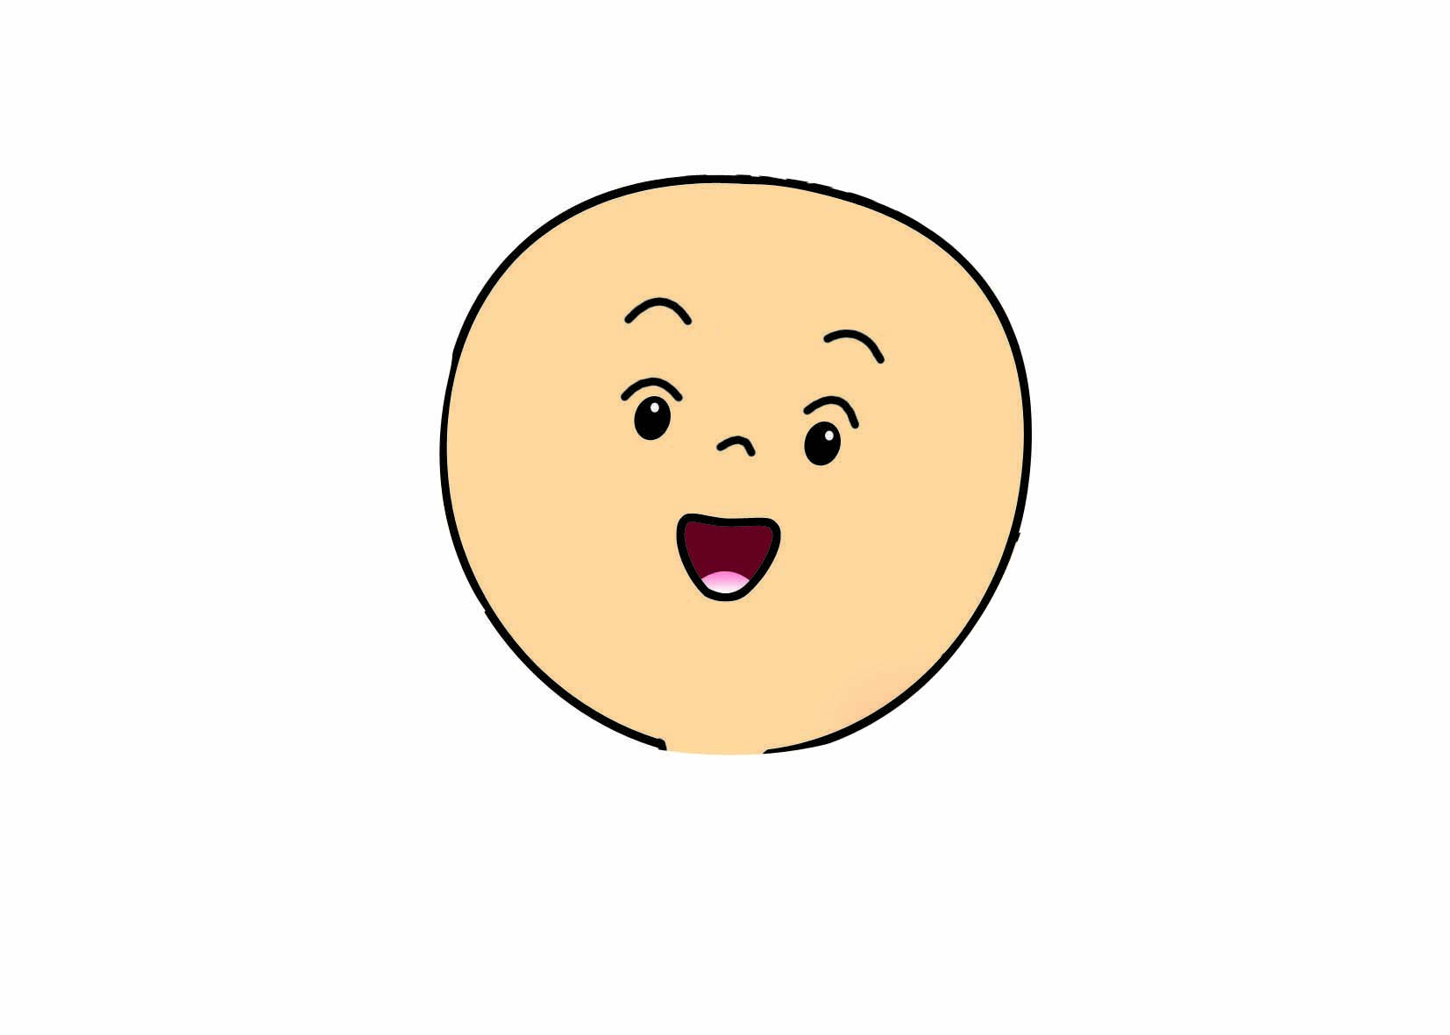
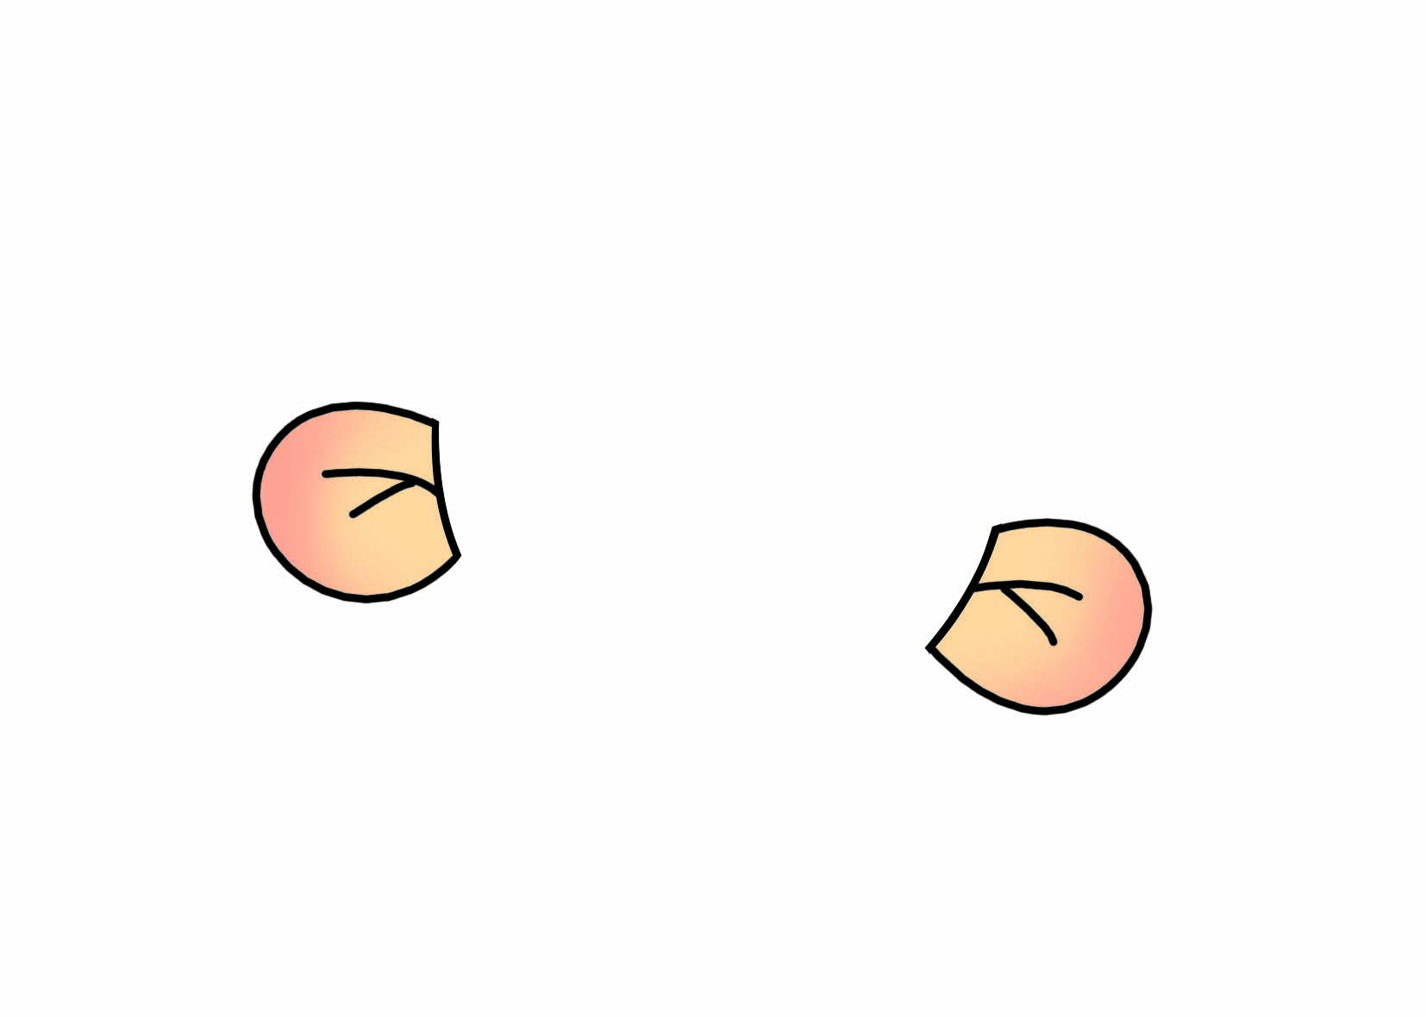
face
eye
nose
mouth
ear
Look at me,this is my .

Slide 17
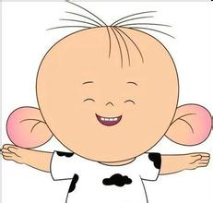
Pair work
A:Good morning.
B: Good morning.
A:How are you？
B:I’m fine,thank you.
A:Look at me.This is my face.
B:Look at me. This is my mouth.

Slide 18
Let's do
I say you do

Slide 19
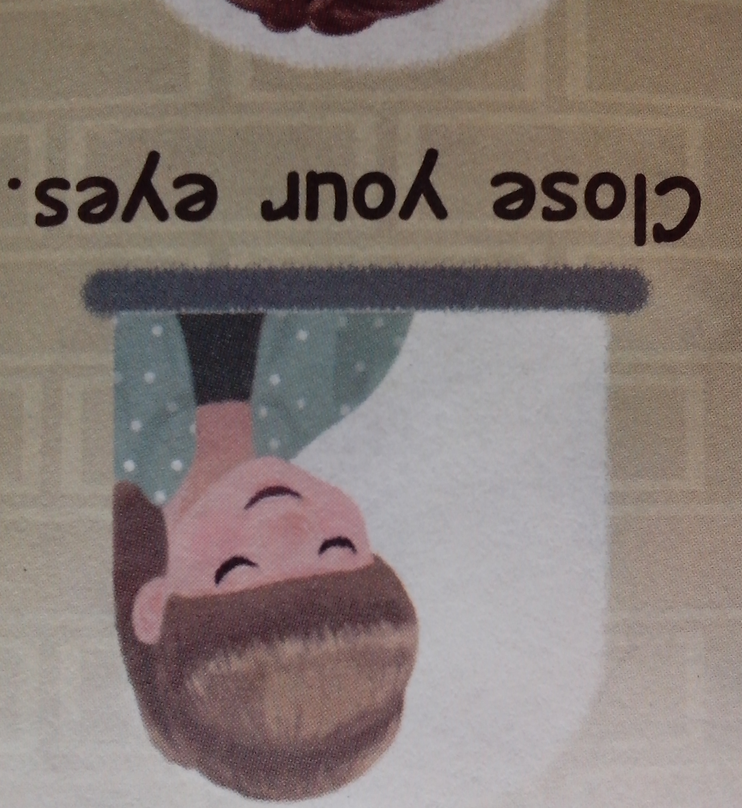
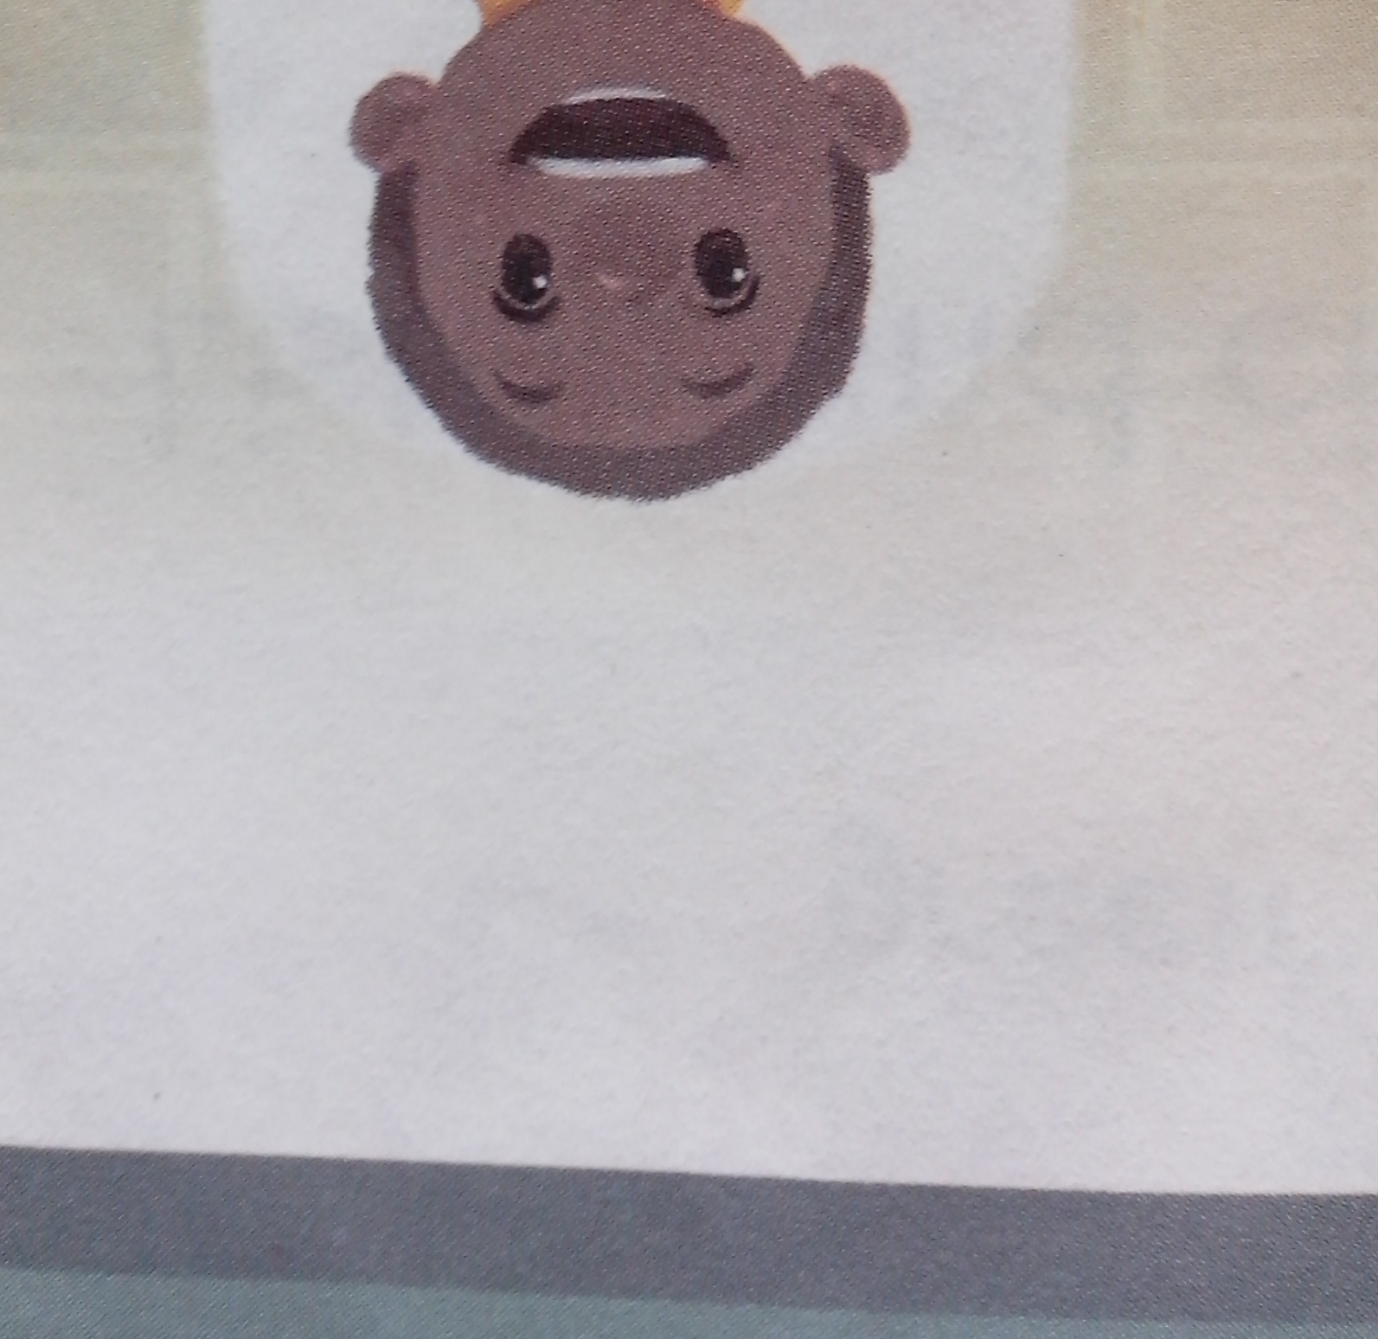
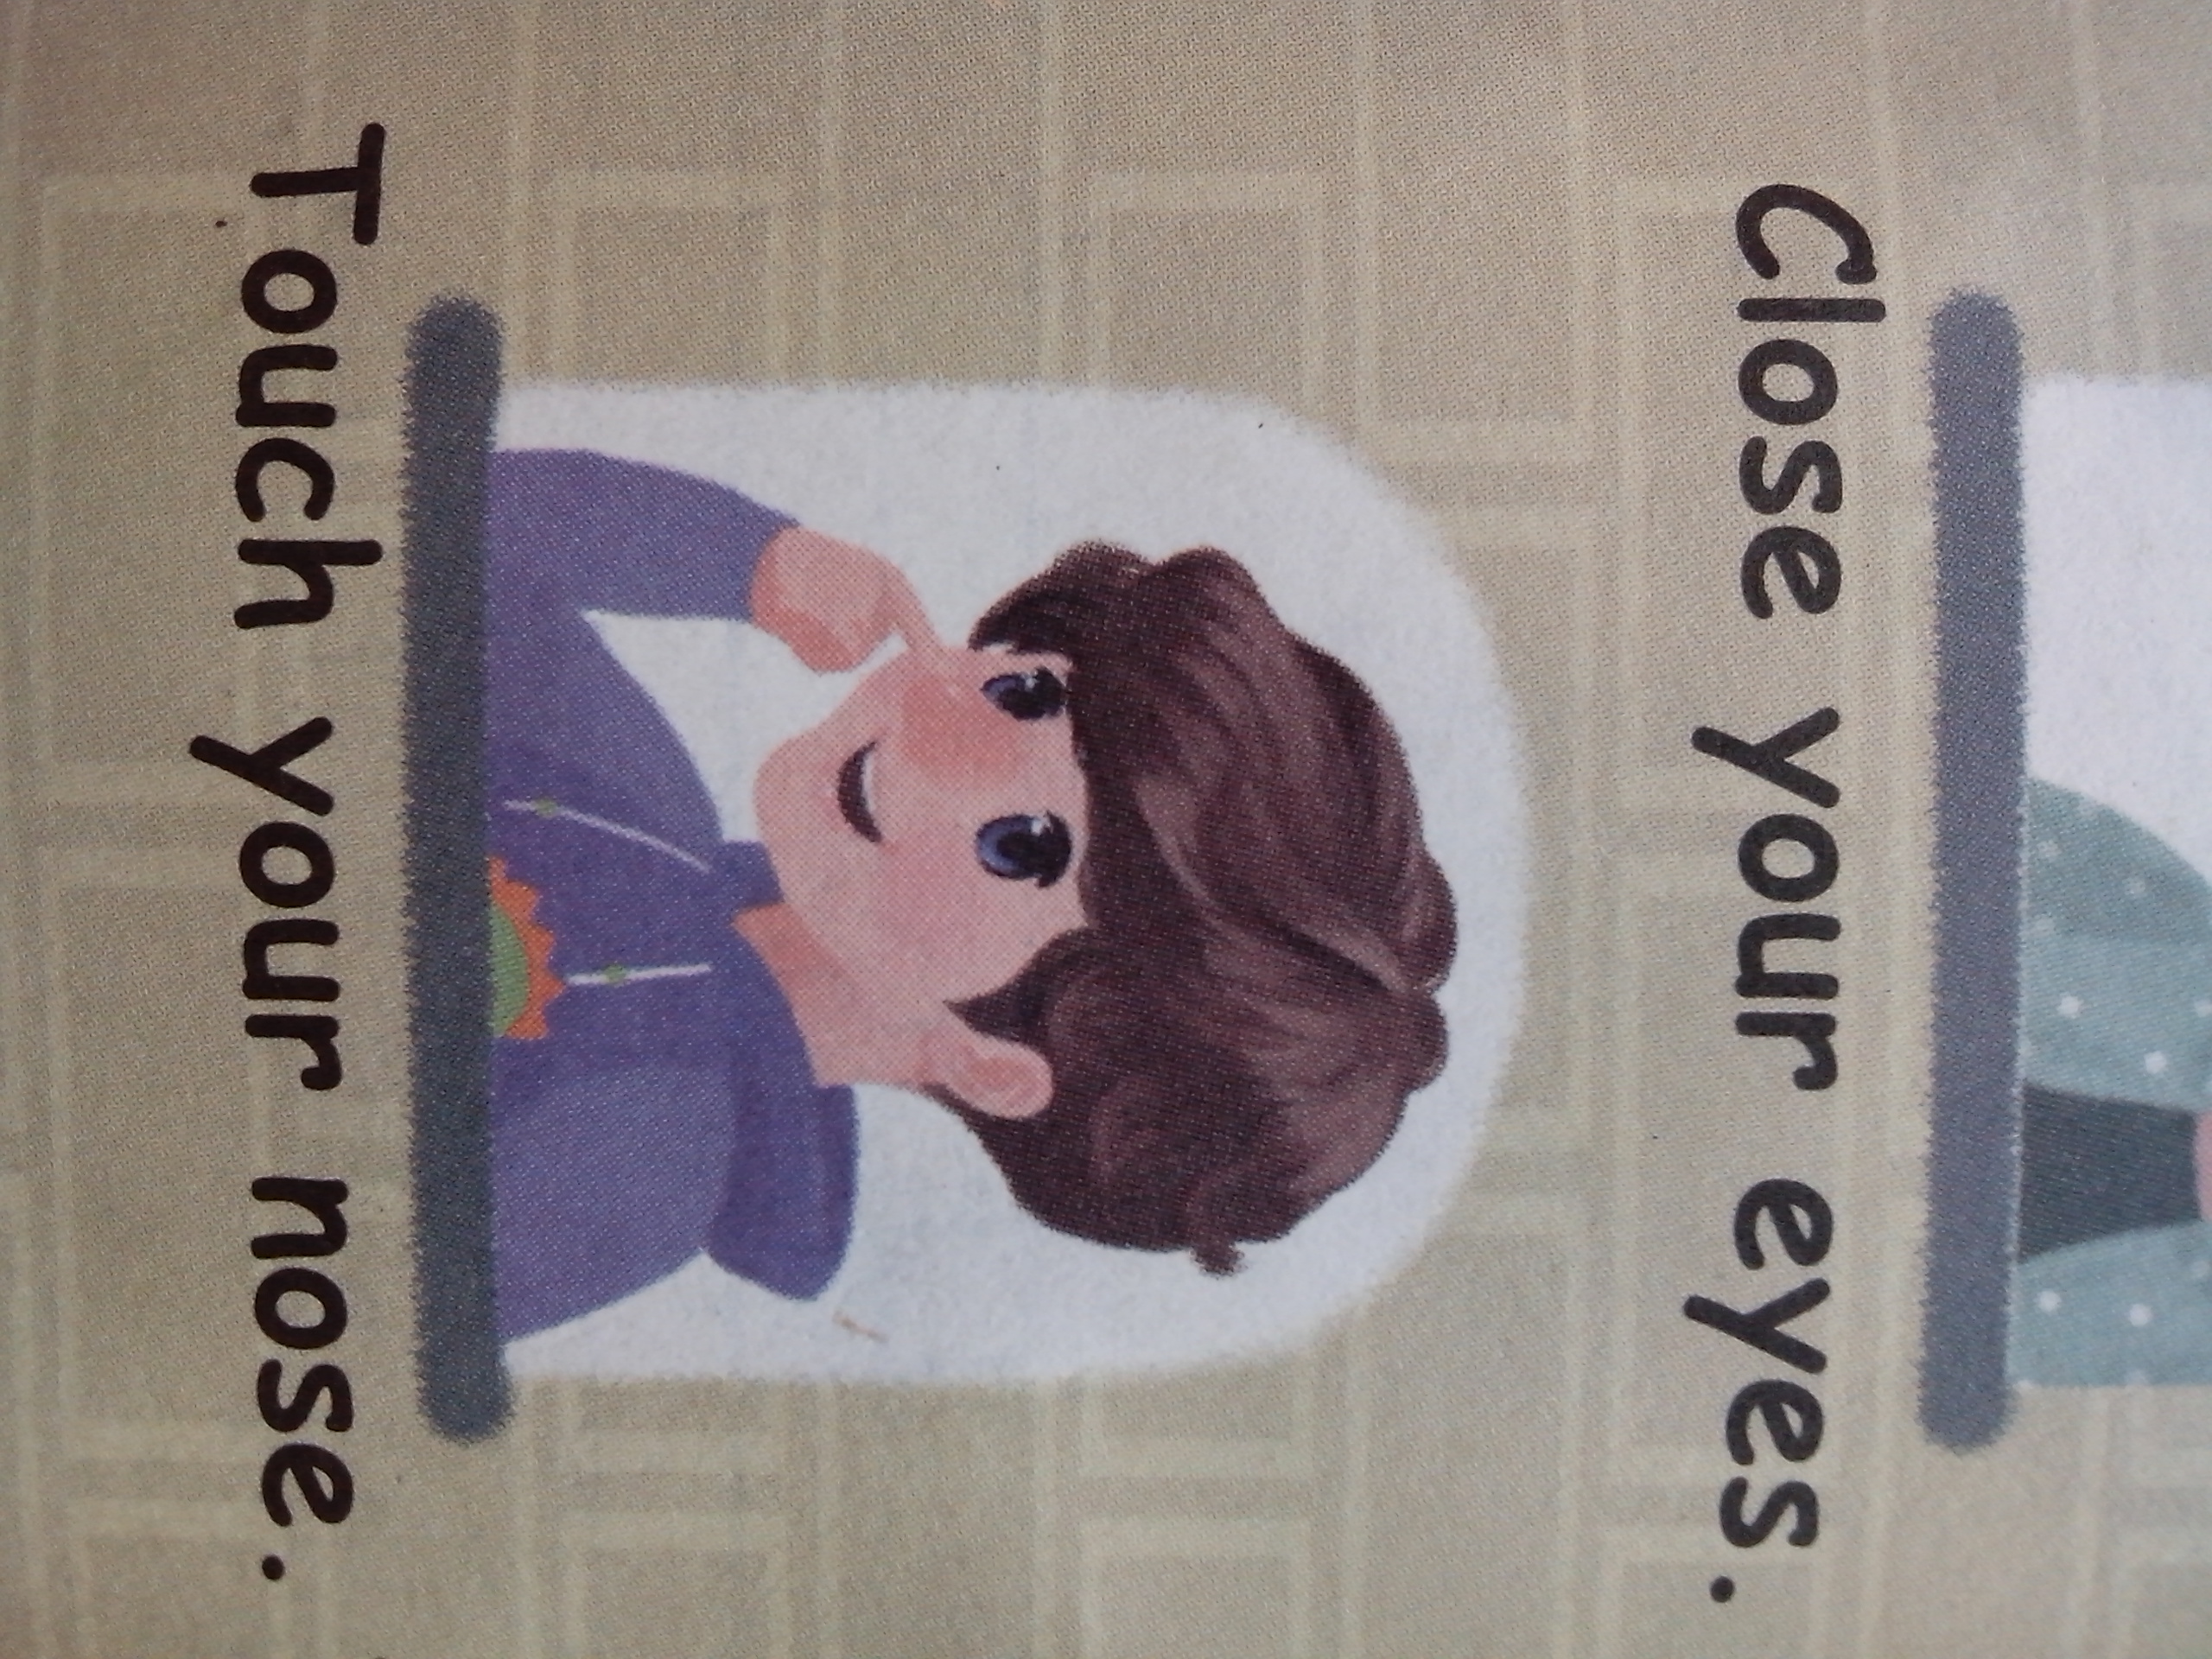
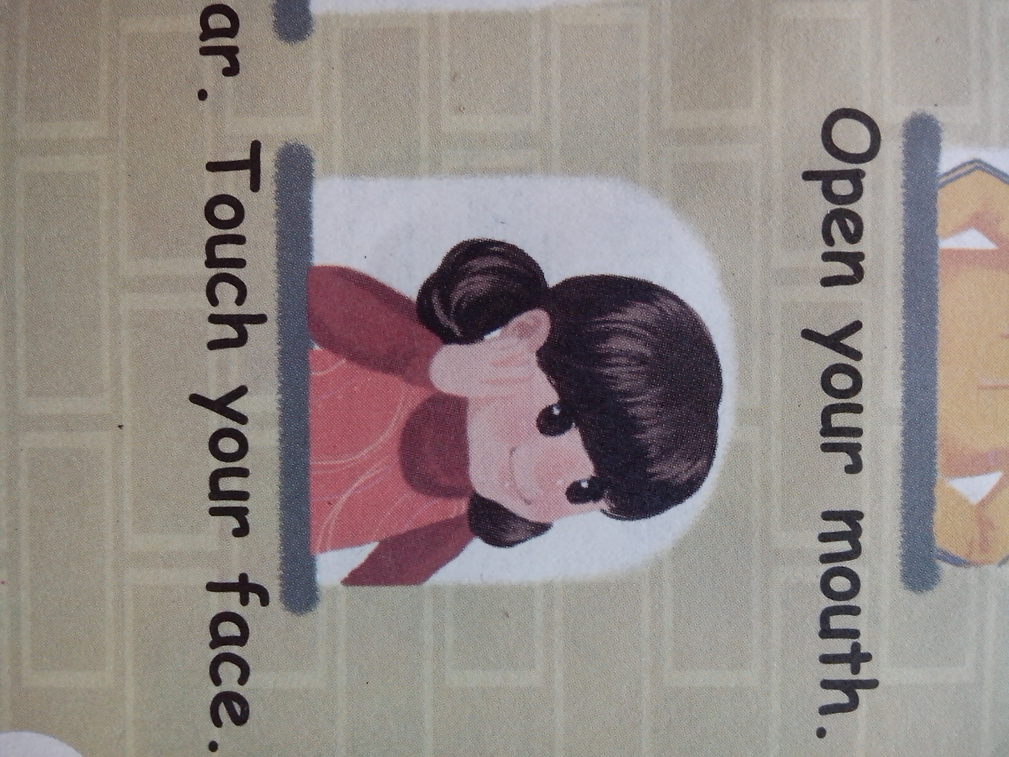
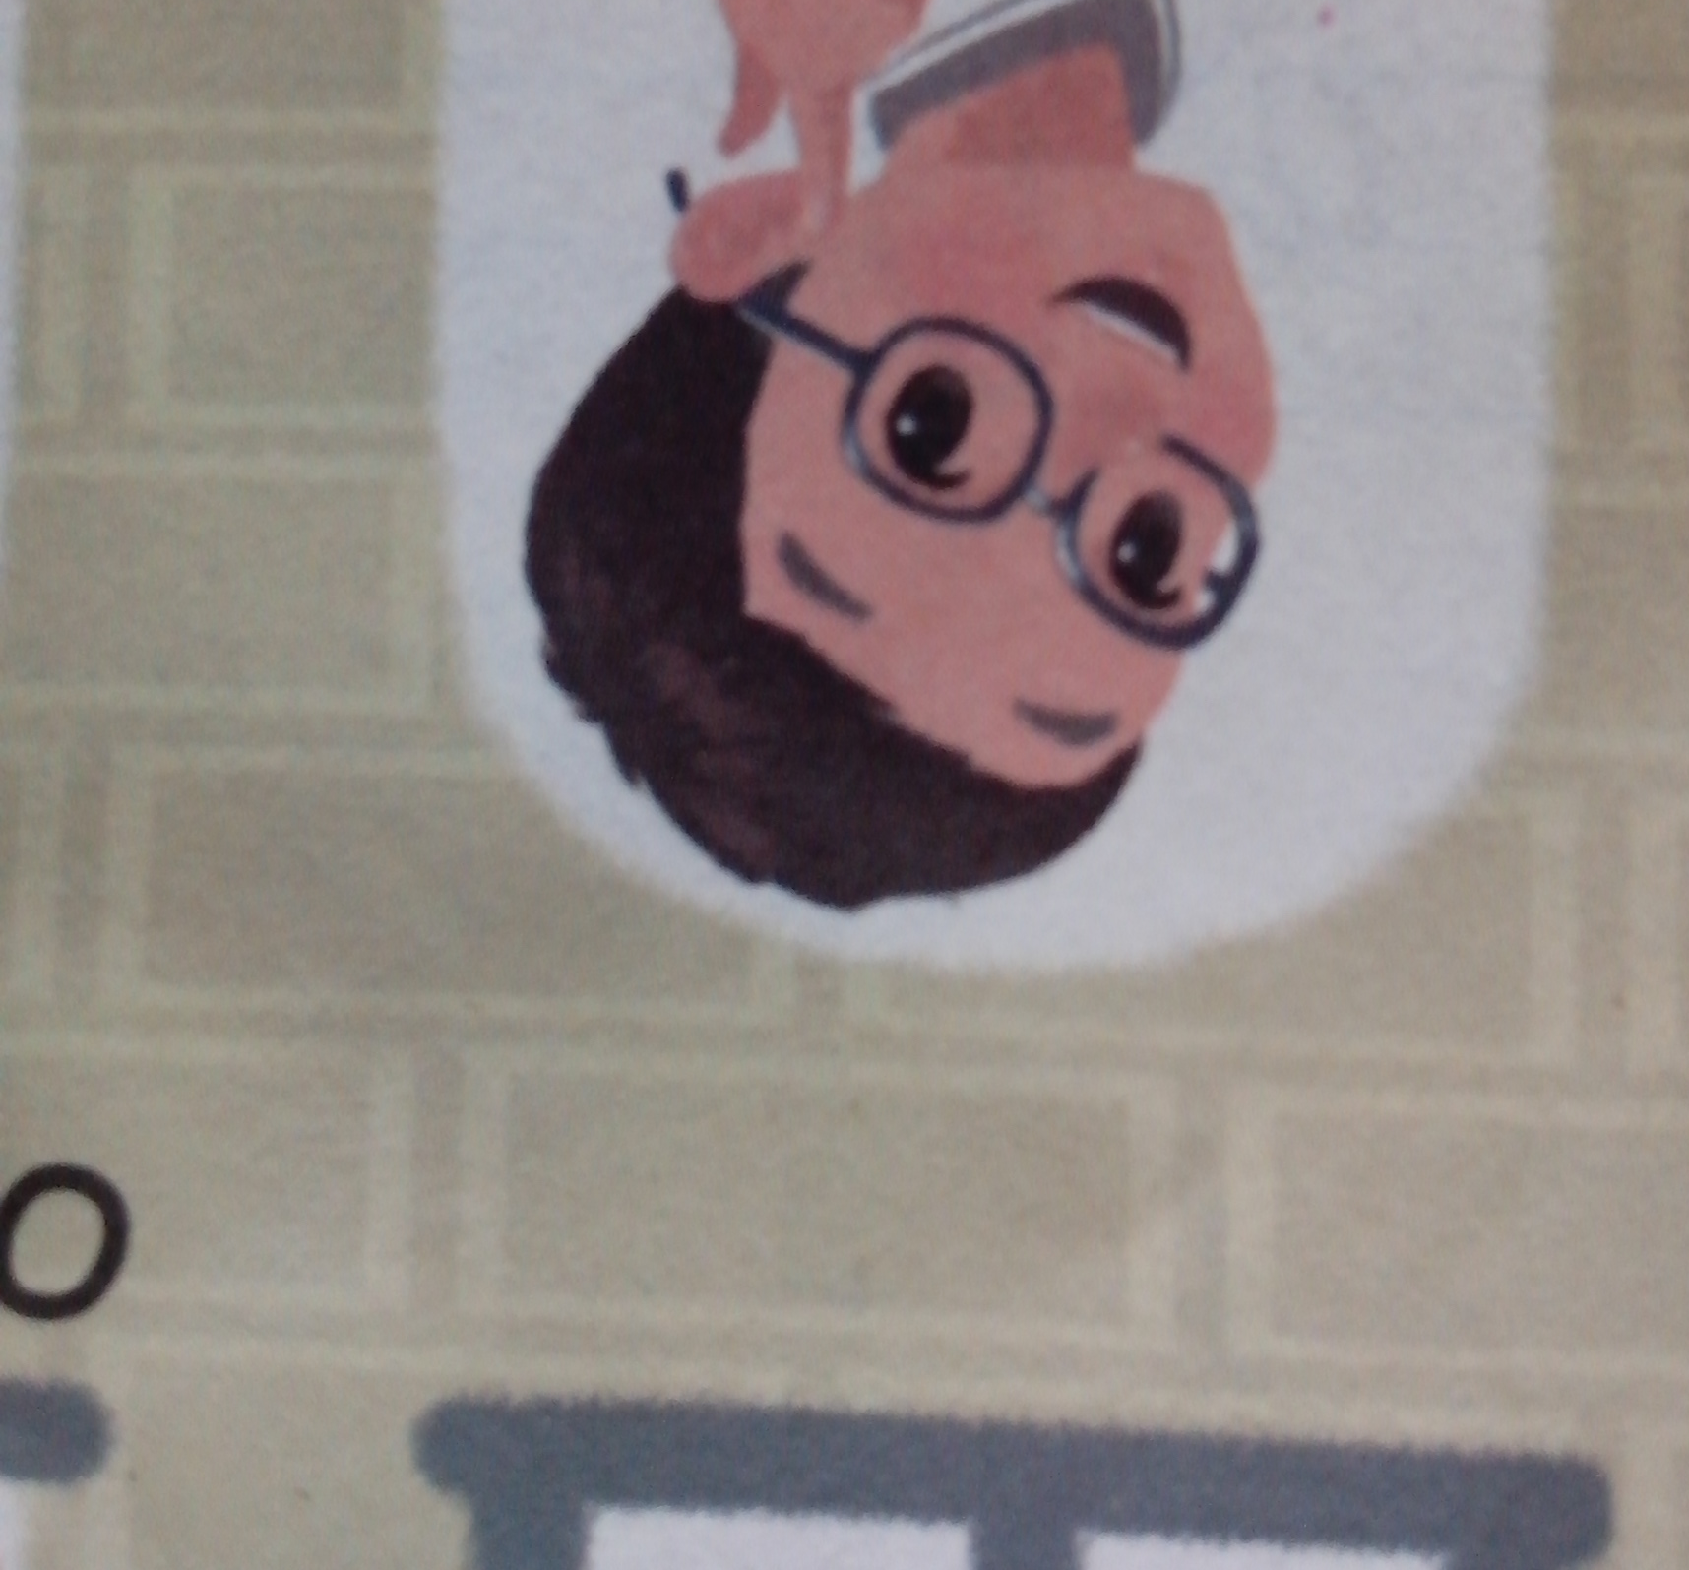

Slide 20
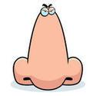
←
I can see with my eye.
←
I can hear with my ear.
←
I can smell with my nose.

Slide 23
Can you say?
A: Good morning!
B: Good morning!
A：Look at me！This is my nose.
Touch your nose！
B：Nose!

Slide 24
See you

